Slide 1
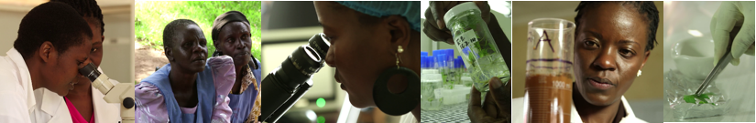




Strengthening Use of Digital Technologies for Agricultural Transformation in Africa: African Digital Agriculture Program (AfriDAP)
Date: 22nd March 2019
Venue: BenGuerir, Morocco

Slide 2


Session Presentation outline
AfriDAP Model
Jude Thadeus Lubega
Pillar 1: E-learning and data sharing
Rafiq EL ALAMI
Pillar 2 (a): Remote Sensing
Ghani Chehbouni
Pillar 2 (b):Data Science
Muliaro Wafula

Slide 3




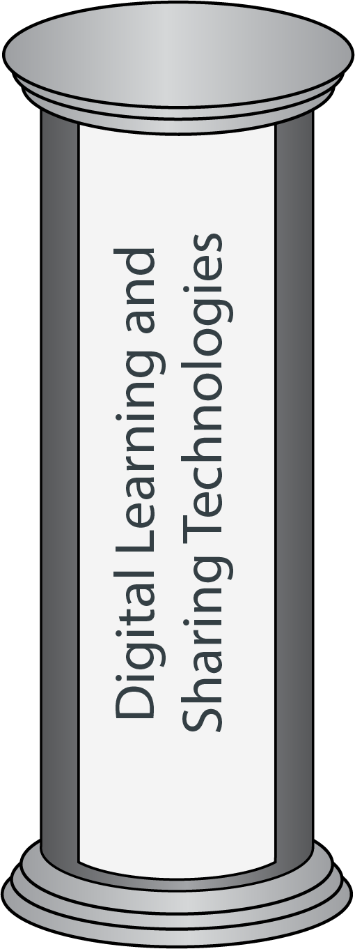

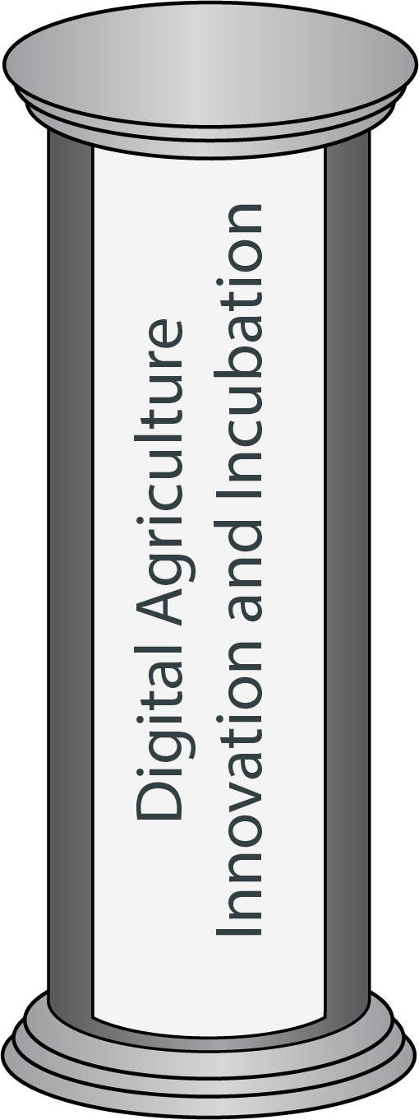



Africa
Agenda 2063
Regional Outcomes
National Outcomes
Skills
Services
Knowledge
Ubiquitous
Education
Insights
Technologies
Startups
Innovations
African Digital Agriculture Program (AfriDAP) in a Nutshell

Slide 4
Possible projects interventions along the thematic areas
Technology-mediated training for digital skills development
Digital platform for information and knowledge management
Nurturing digital agriculture, innovations and enterprises
Access to affordable use of fertilizer to small holder farmer
Policy harmonization

Slide 5
PILLAR ONE:
Digital Learning and Sharing Technologies for Agriculture

Slide 6
Why?
How many University are fully digital or Offer digital learning programs in Africa?
How many
  Universities are offering a Master in “ Agriculture Topic A”?
  Students are Enrolled in Masters/PhD in Agriculture?
  ...
No other way but “sharing courses”…
  Simple Math
    8 Months per MOOC
    18 courses per Master

Slide 7
Digital University Initiative
Outcomes:
Build Online Course Development Capacity of the university
Produce a MOOC about “Digital and Agriculture”
Implement Management Systems and Course delivery systems
Share the course and select information through the Knowledge Hub
Needs:
Pilot the program for 6 universities
Scale it to more RUFORUM members
Partner Students
Partner
Researchers
Other
Knowledge Hub
University 1
University 2
…

Slide 8
PILLAR TWO:
DATA SCIENCE DEVELOPMENT
1- Remote Sensing and Data Science
2- Data Science Policy

Slide 9
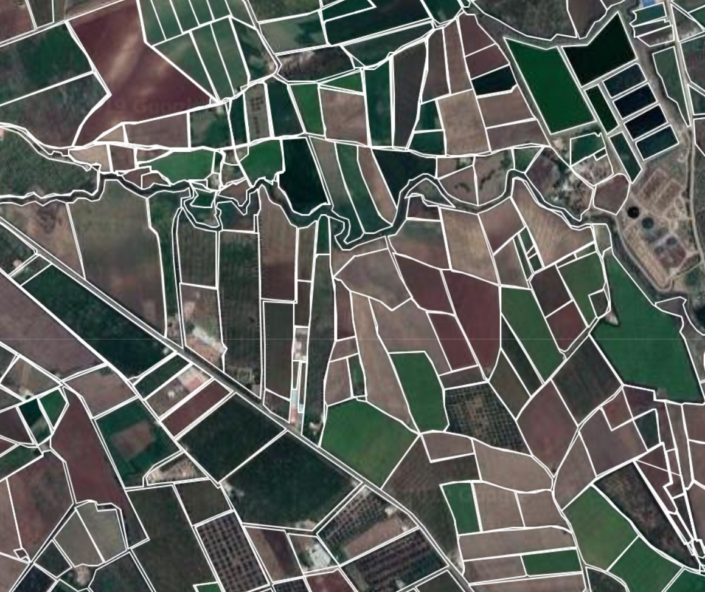
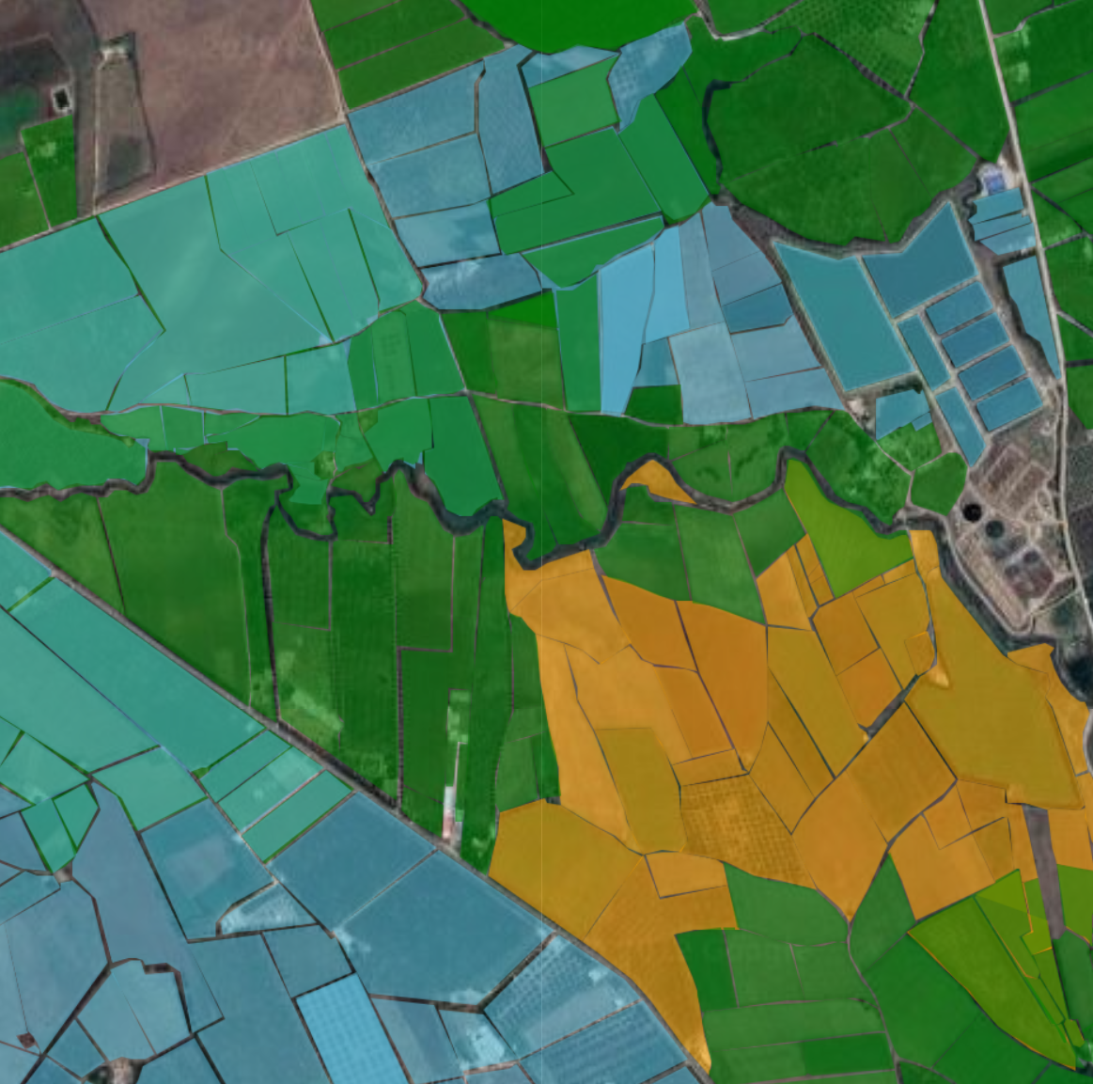
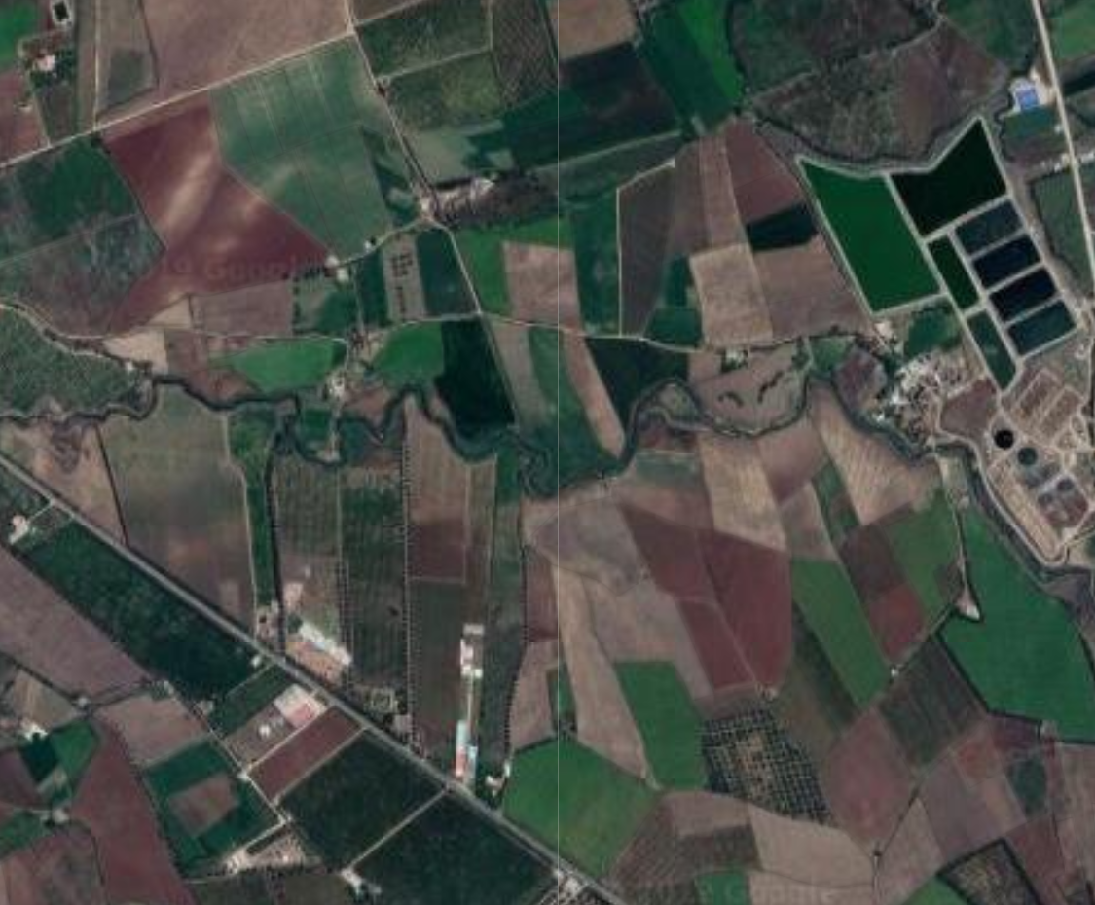
Initiative 1: Remote Sensing Why?
Automatic detection of
  Parcel delimitation
  Parcel Area calculation
  Crops usage
  Water management needs
  Yields
  …
Free Satellite images with up to 10m resolution and 5 days repeatability
  Historical data re-generation

Slide 10
Initiative 1: Remote Sensing
Outcomes:
Develop Remote Sensing Centers of Excellence (Training/Research Programs/Capacity Building)
Develop Data Science Centers of Excellence
Locally host Satellite Data and Replicate with Other Countries
Open Data and Services sharing to speed up research
Needs:
Initial Pilot of the program
Scale it to more RUFORUM members

Slide 11
Initiative 1: Remote Sensing
Outcomes:
Develop Remote Sensing Centers of Excellence (Training/Research Programs/Capacity Building)
Locally host Satellite Data and Replicate with Other Countries
Open Data and Services sharing to speed up research
Needs:
Initial Pilot of the program
Scale it to more RUFORUM members

Slide 12
Data Science
Why?
Once we have data
  Need to be able to make sense of it
  Then other questions need to be answered
    What can we do with it?
    What can be shared?
    How do we comply with global rules?

Slide 13
Initiative 2:
Data Science Policies
Outcomes:
Agriculture Data Science Institute
  Training
  Research
  Policies
  Best Practices
Needs:
Initial Pilot of the program
Scale it to more Countries

Slide 14
PILLAR THREE:
DIGITAL INNOVATION AND INCUBATION
This will be mostly address through the proposed Accelerating youth innovativeness, entrepreneurship and financial inclusion for Africa’s development (AYIF-Africa) program in workshop session 2

Slide 15







Email Us:
secretariat@ruforum.org
Like Us on Facebook: ruforumnetwork
Follow Us on Twitter: ruforumsec
Visit Our Blog:
http://blog.ruforum.org/
Visit Our Website: www.ruforum.org

